Slide 1
USED CAR PRICE PREDICTION
Aditi Aserkar
Bhagyashri Raghunath Gadkari
Shilpa Nidhi Kirubanidhi
Group No:4

Slide 2
Problem Definition
Our goal is to predict the prices of used cars using machine learning models. We also identify important features of the car that influence its price in the market. This prediction will be of use to:
Used car dealers: Dealers can benefit from this as they can better understand the important features of the car that influence the price, and what makes a car desirable.
Online car pricing websites: This prediction may be used as a point of reference pricing websites and as a result, they can list a better price estimate.
Individuals who are interested in selling/purchasing a car: People can better understand the market value of their used cars and fix a price accordingly.

Slide 3
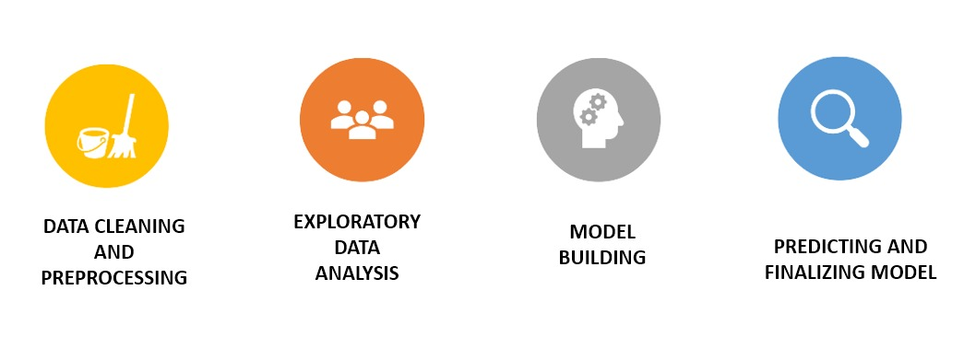
Approach

Slide 4
Data set
Categorical fields | Numerical fields
url | id
region | price
region_url | VIN
manufacturer | year
model | odometer
condition | lat
cylinders | long
fuel
title_status
transmission
drive
type
paint_color
state
posting_date
image_url
description
county
state
https://www.kaggle.com/datasets/austinreese/craigslist-carstrucks-data
No. of records: 397896
No. of columns: 26

Slide 5
Data cleaning
1. Drop the unnecessary columns:
Id, URL, region, region_url, lat, long, VIN, image_url , description, size and county
2: Drop the duplicate records
3: Filling NULL values of categorical columns: Using FFILL method
Condition: filled based on odometer reading
4: Filling NULL values for numerical columns (Odometer):
Create column age =Posting_Date-year
Substituted NULLS with the median value of odometer grouped by age
5: Removing outliers – Odometer and price
Remove the outlier data by calculating quartiles with upper limit=99th percentile and lower limit=1st percentile.

Slide 6
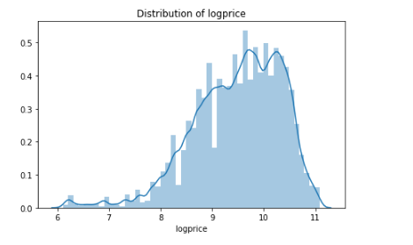
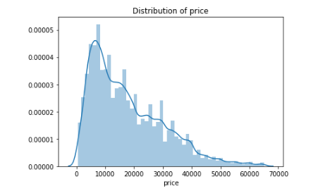
Exploratory data analysis
Distribution of price:

Slide 7
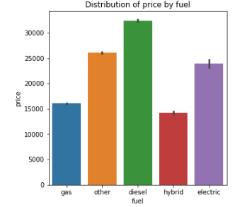
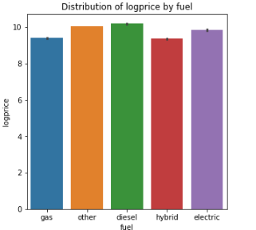
Exploratory data analysis (Contd.)
Distribution of price by fuel:

Slide 8
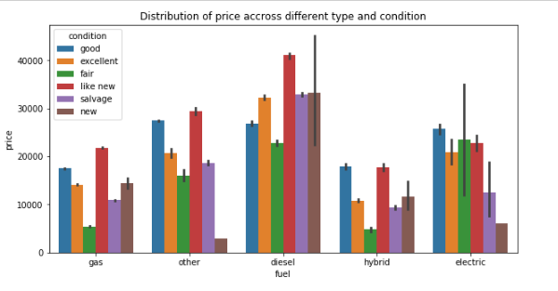
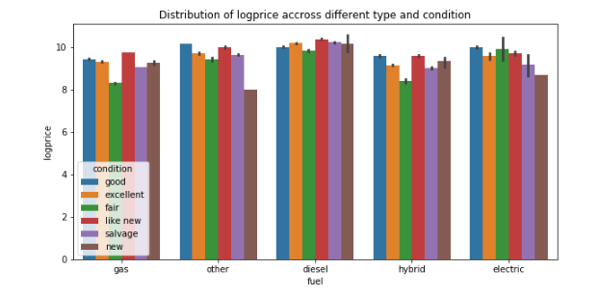
Exploratory data analysis (Contd.)
Distribution of price across different type and condition:

Slide 9
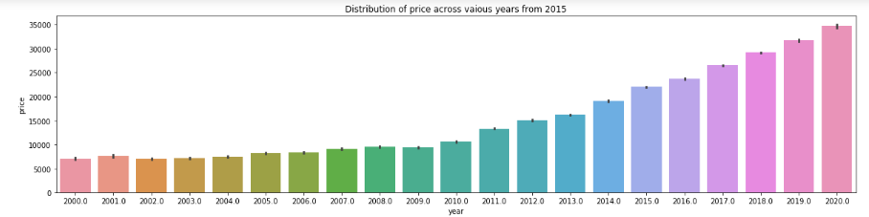
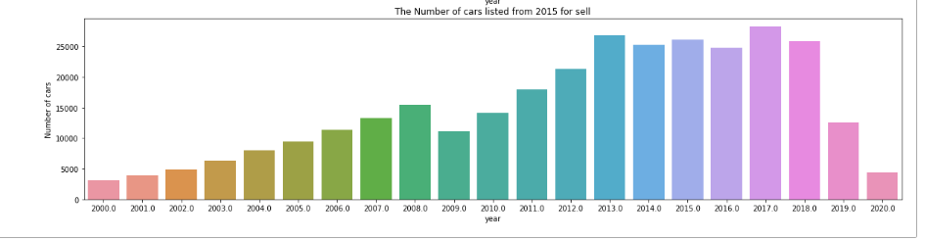
Exploratory data analysis (Contd.)
Distribution of price across various years from 2000
The number of cars listed for sell from 2000:

Slide 10
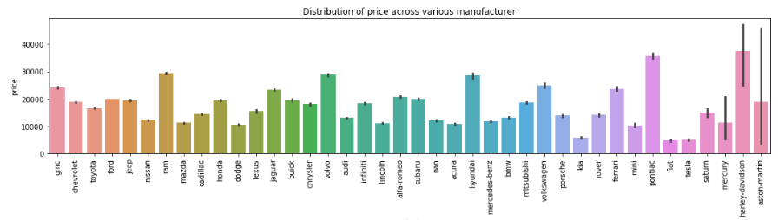
Exploratory data analysis (Contd.)
Distribution of price across various manufacturer:

Slide 11
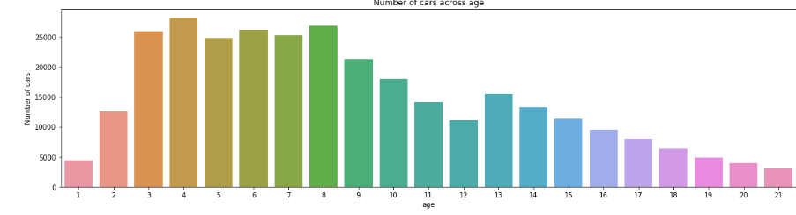
Exploratory data analysis (Contd.)
Number of cars across ages:

Slide 12
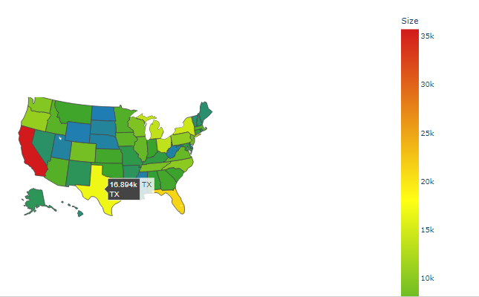
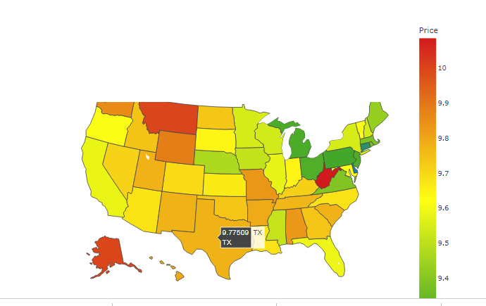
Exploratory data analysis (Contd.)
Median prices of car by state
No. of listings by state

Slide 13
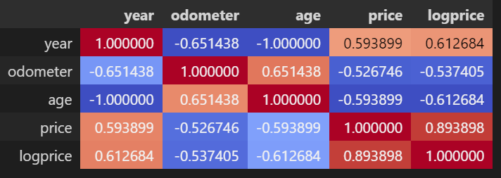
Exploratory data analysis (Contd.)
Correlation matrix:

Slide 14
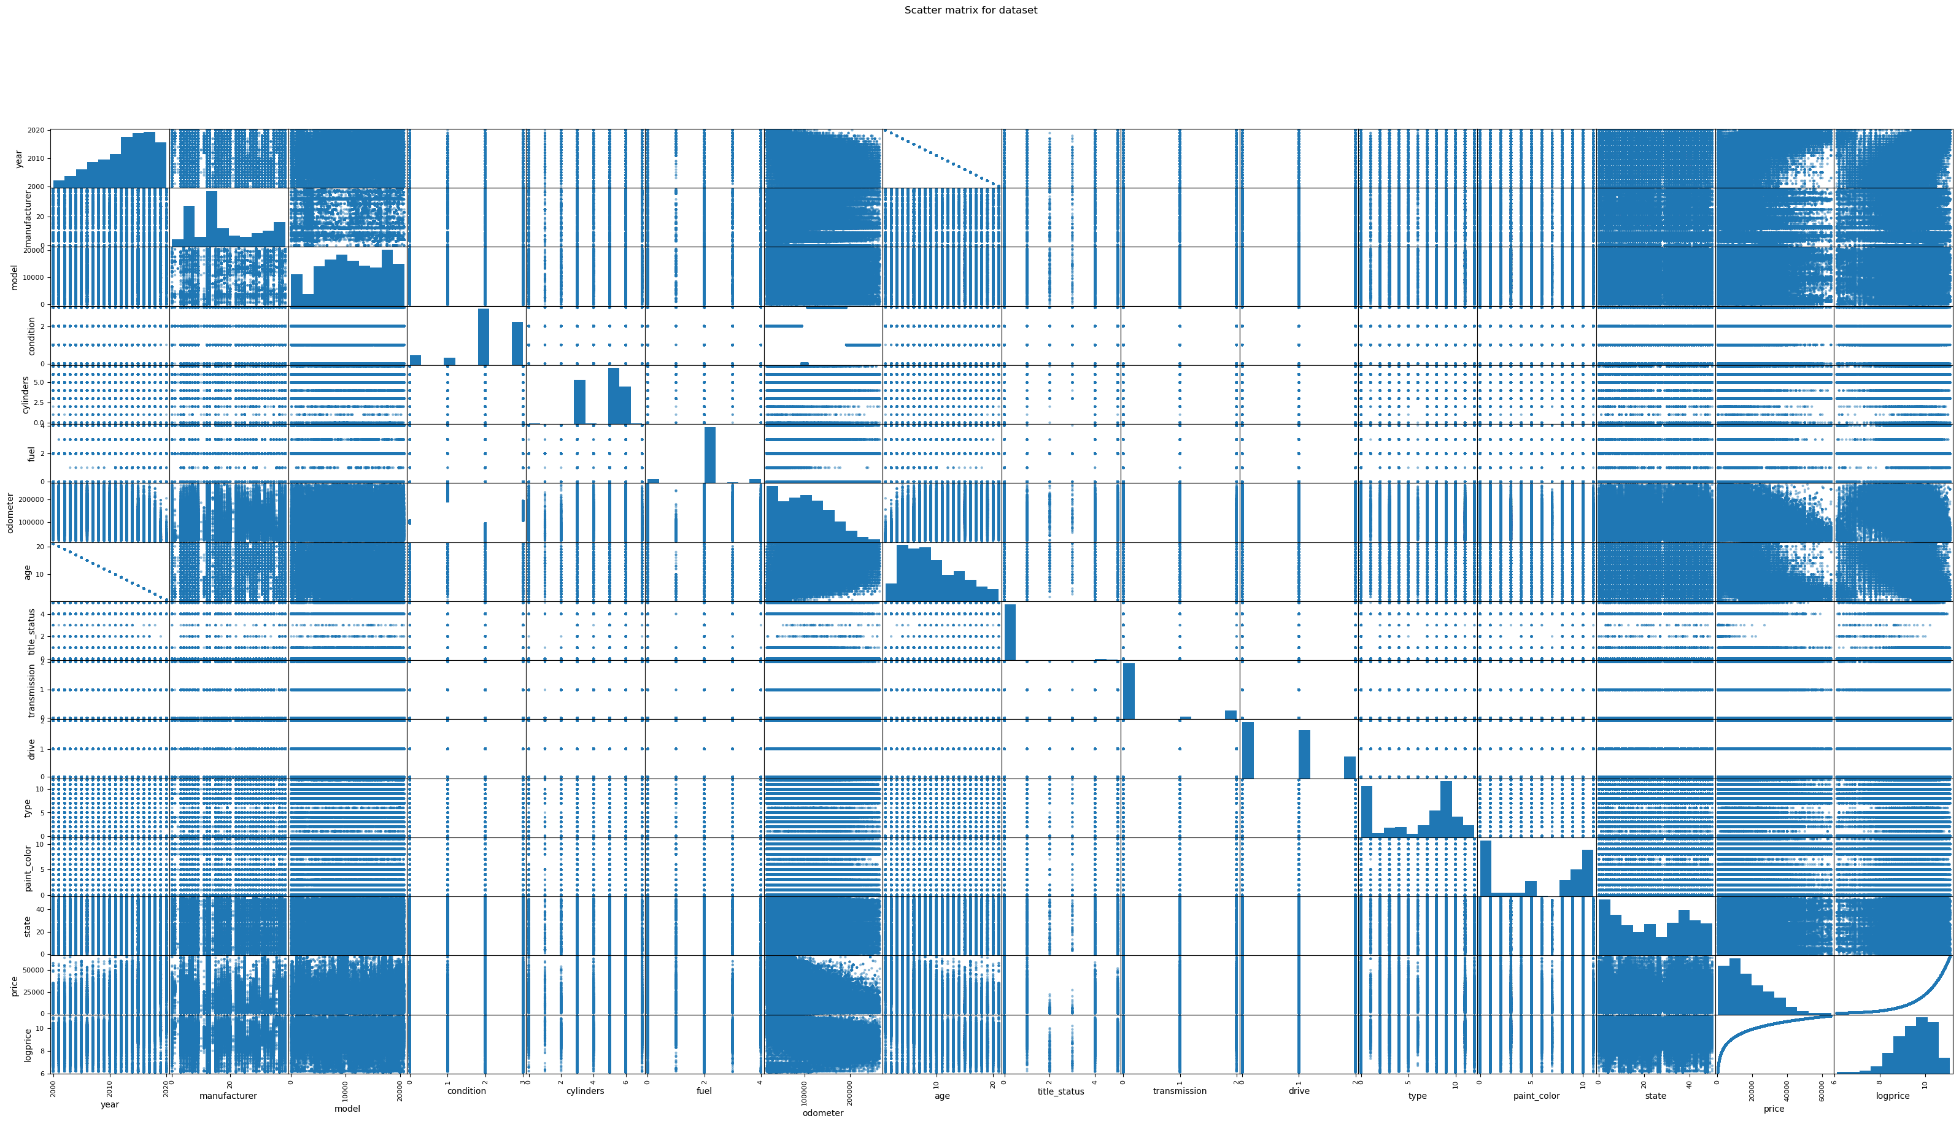
Scatter matrix

Slide 15
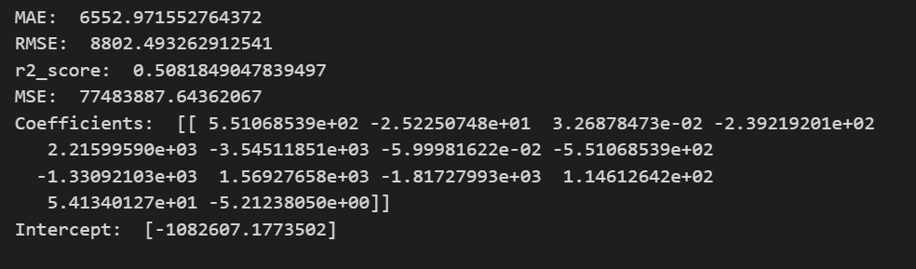
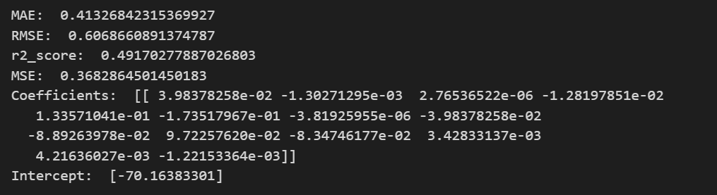
Price prediction: Linear regression
Target: Price
Target: Logprice

Slide 16
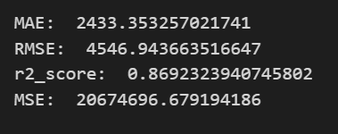
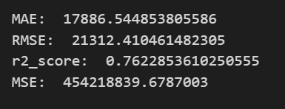
Price prediction: Random forest regressor
Target: Price
Target: Logprice

Slide 17
Insights
As per our findings, Random forest model fits data and measures 86 % variance in the car price that is predictable from the car features
In our analysis, year, odometer, age, model and fuel are the most impactful features.
It is a challenging task as large number of features need to be considered and collected. In future we would like to collect more accurate data and use advanced machine learning algorithms for better prediction.

Slide 18
Thank You!

